Slide 1
Foraging: How long do we spend helping others?
Emma Scholey
3rd September 2025
CSC 2025 Birmingham
Notes:
Intros

Slide 2
Group work aims:
Understand how foraging theory can be used in decision neuroscience
Learn how to implement softmax and reinforcement learning (RL) models
Get hands on experience in MATLAB with model simulation and fitting
BONUS: Generate your own ideas to extend the modelling/experiments
Have fun and help each other out!

Slide 3
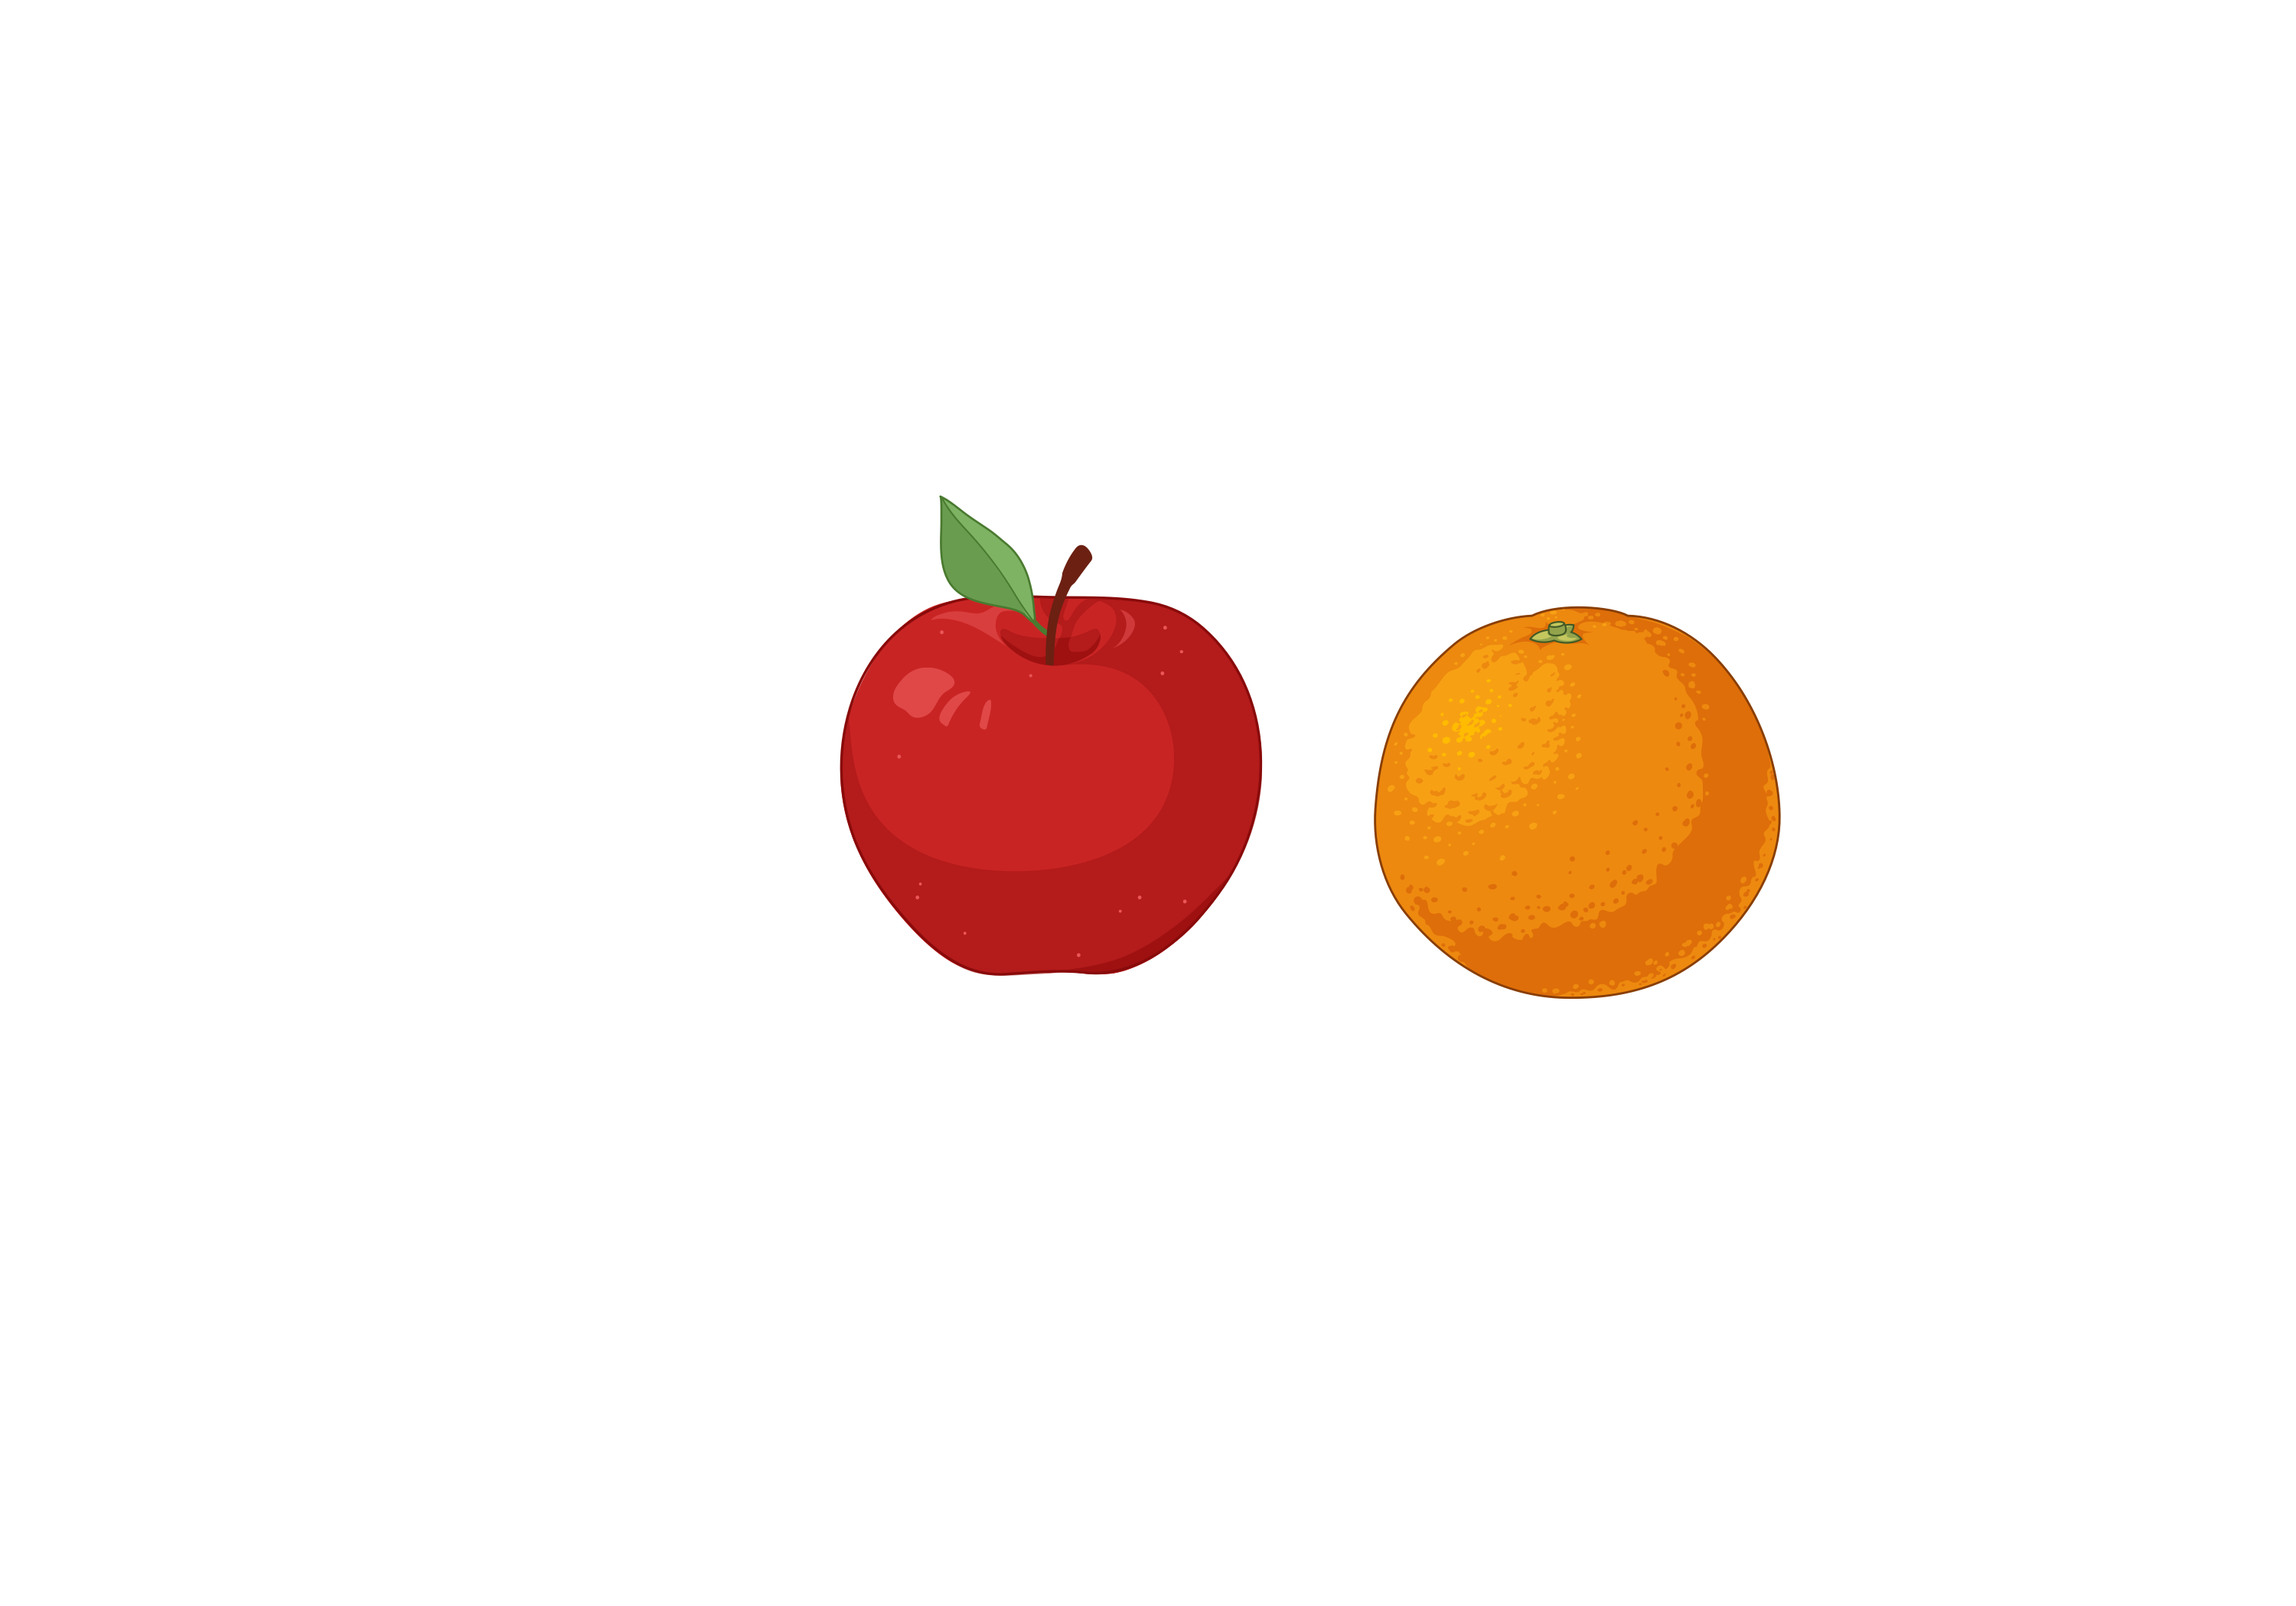
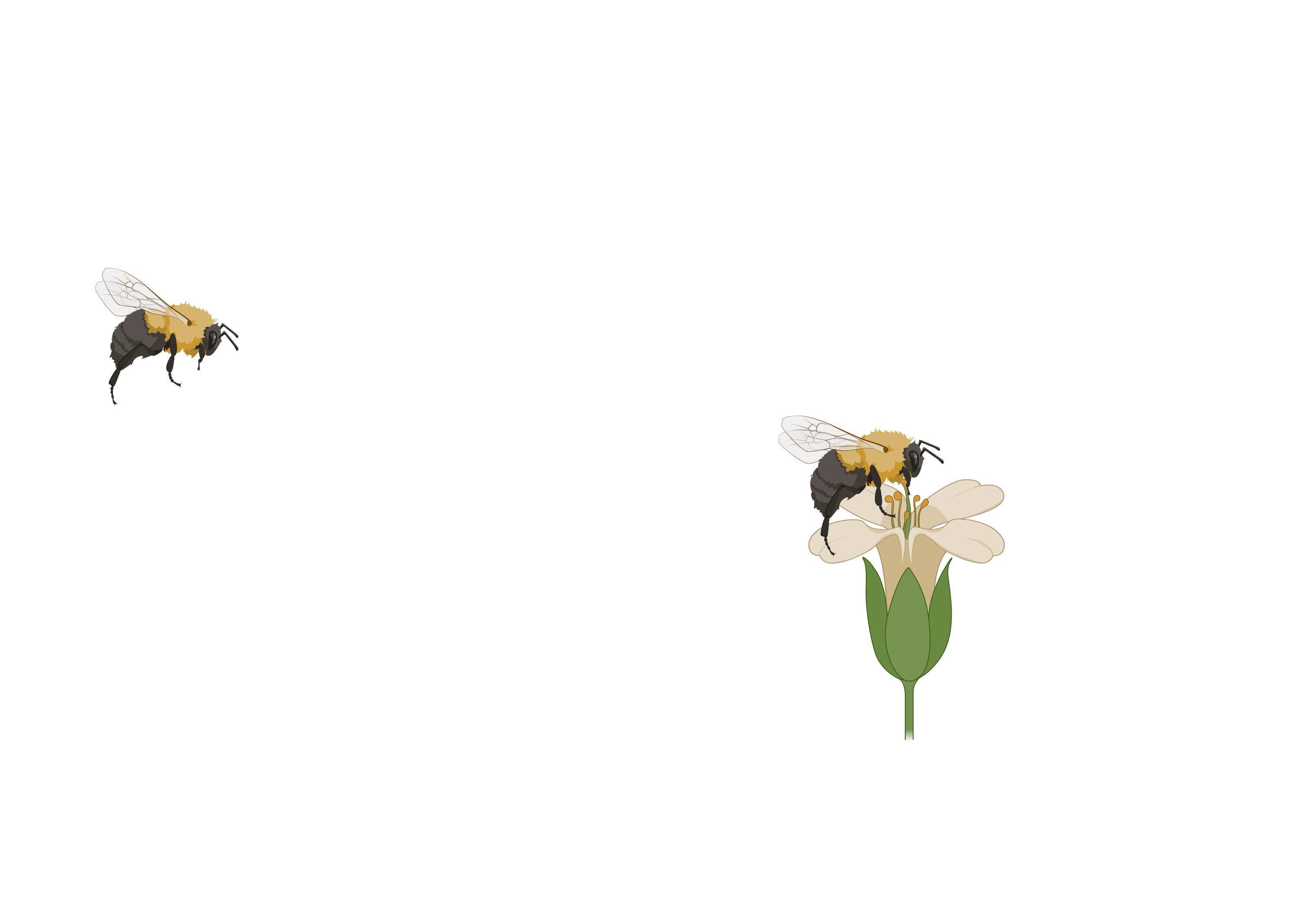
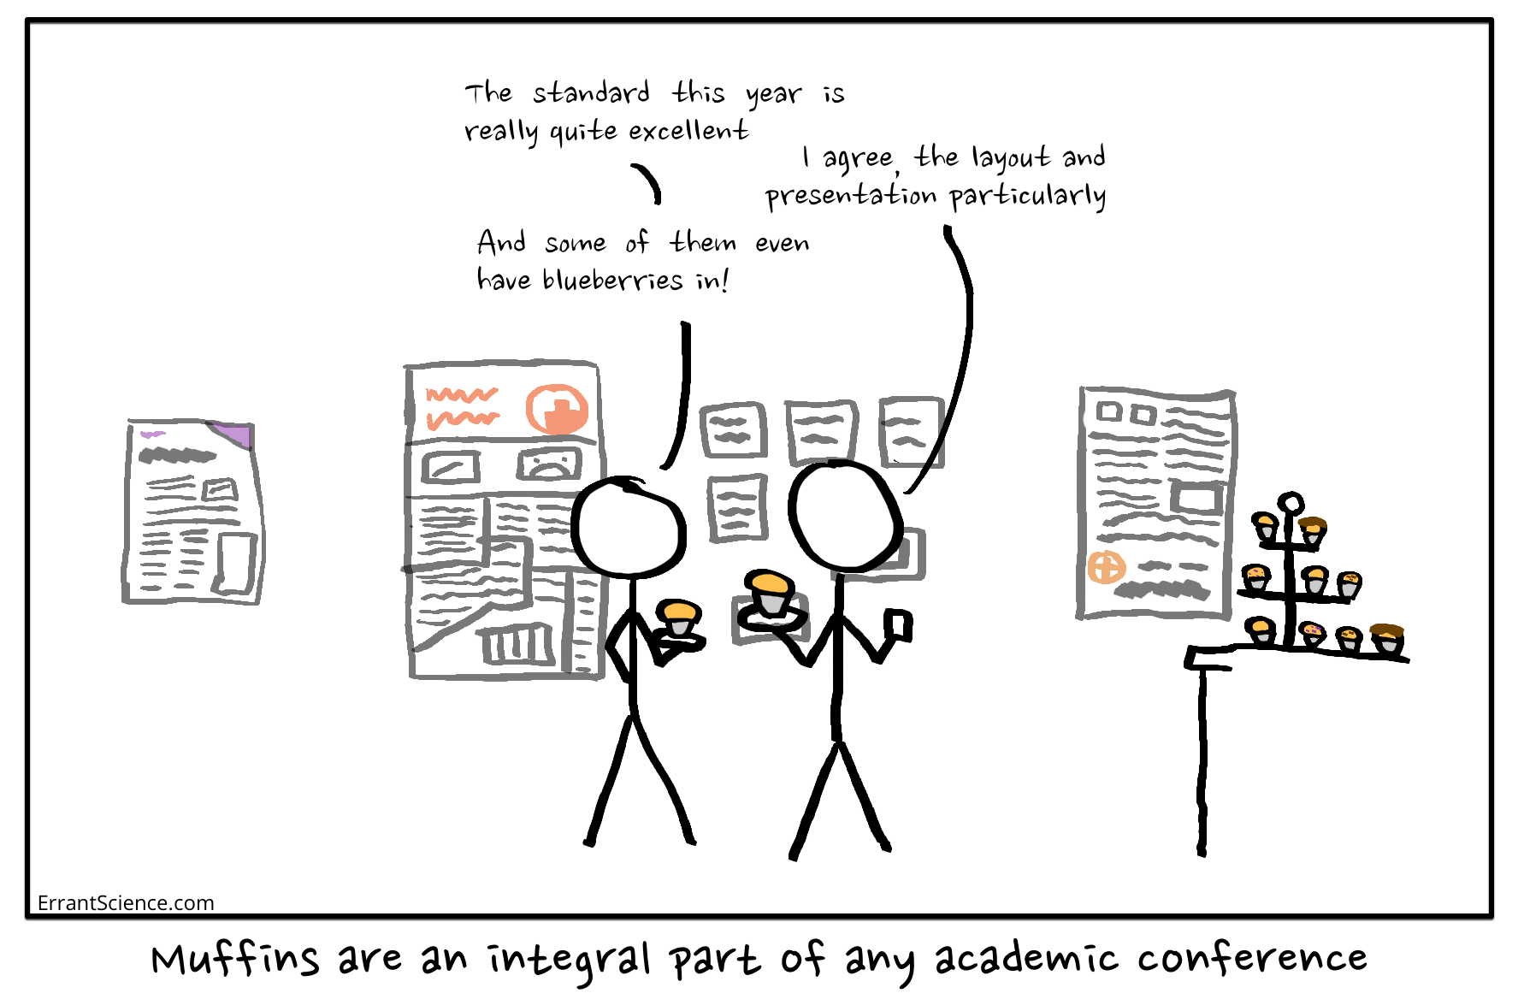
Naturalistic behaviours: simultaneous vs sequential choice
Simultaneous choice: which option to choose?
Sequential choice:
how long to commit to this option?
A
B
70% success rate
30% success rate
Image: BioRender/ ErrantScience.com

Slide 4
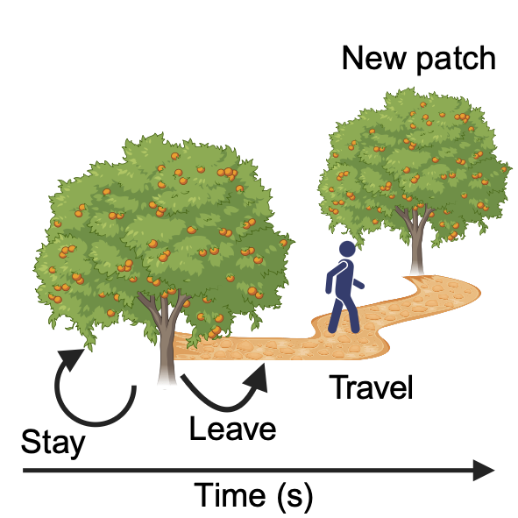
Patch foraging: how long to commit to an option
Deciding to stay and exploit depleting reward, or leave and explore alternatives
Patch reward rate
Patch
Explore
Resource
Exploit
Image: BioRender

Slide 5
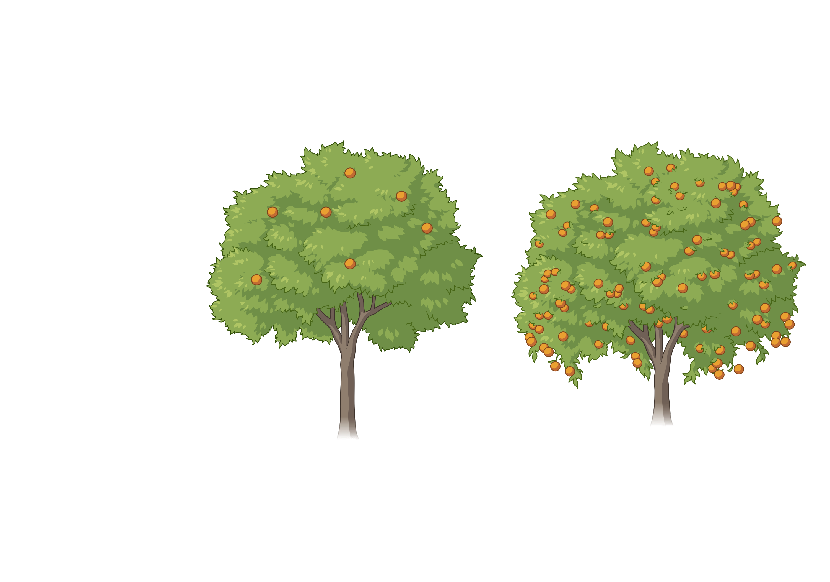
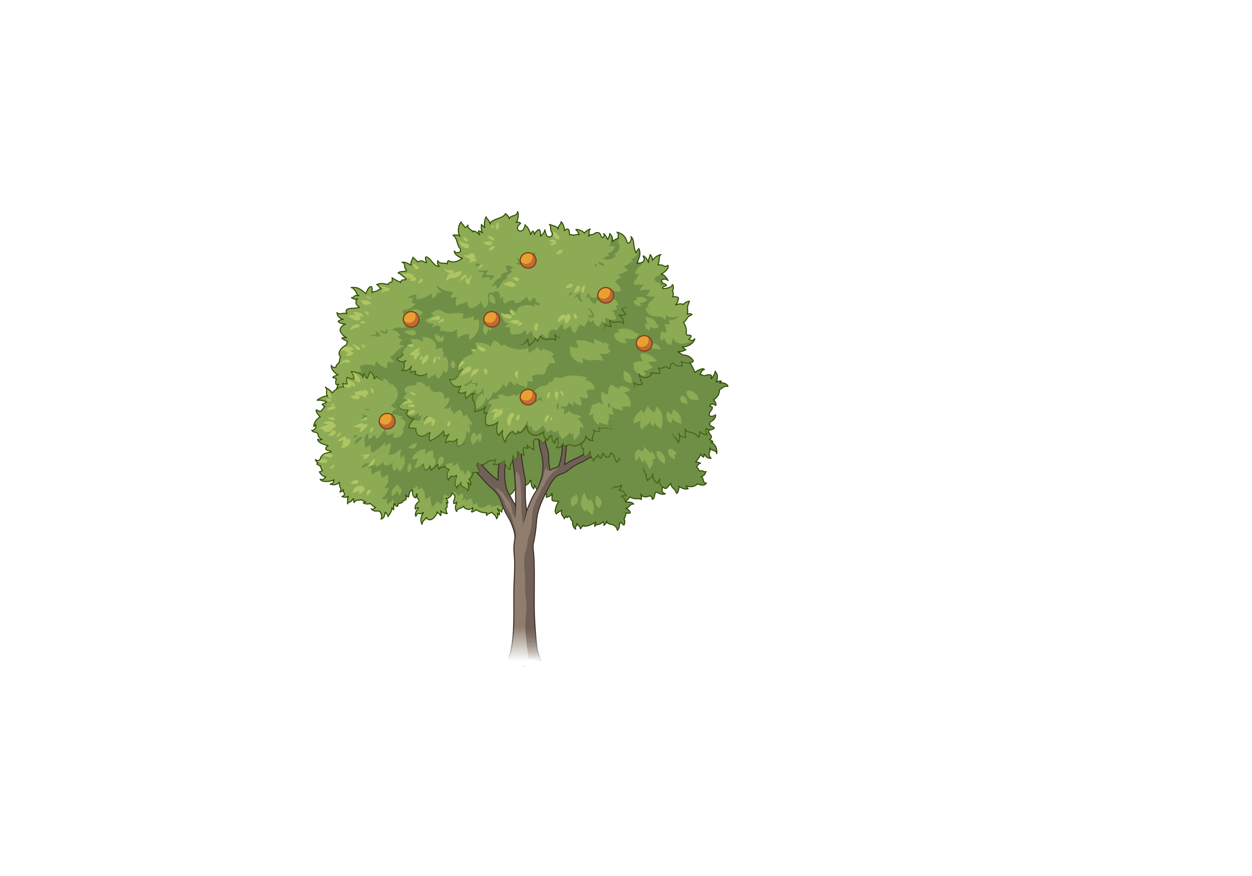
Optimal foraging: Marginal Value Theorem (MVT)
Leave when:
BRR > r
BRR, background reward rate
‘Optimal foraging, the marginal value theorem’
Charnov (1976)
Rich
r, patch reward rate
Poor
Image: BioRender

Slide 6
Foragers approximate MVT
30
Patch effect
Subjects
20
Patch leaving time (s)
Poor
Environment effect
Rich
10
MVT
0
Low
Mid
High
Patch yield

Slide 7
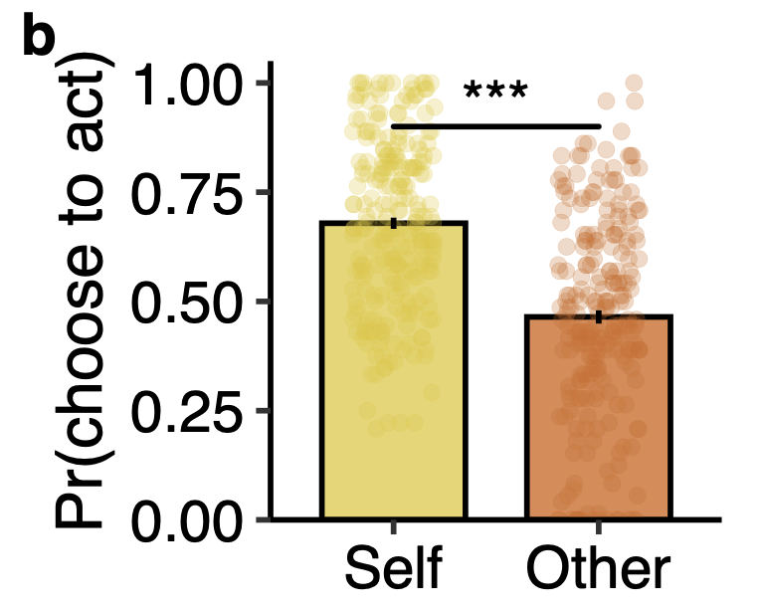
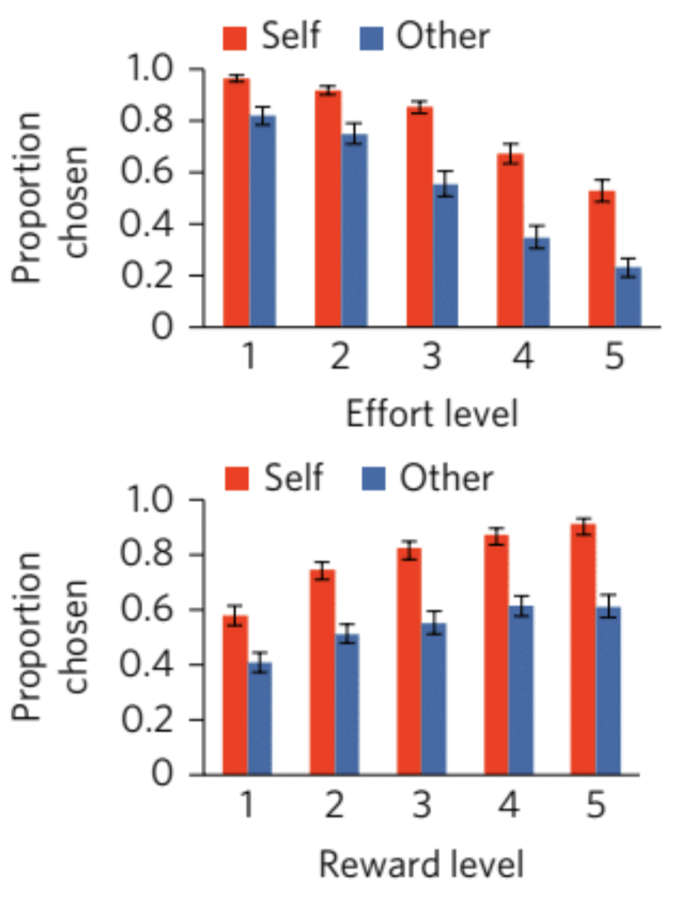
What about foraging for other people?
People are less willing to exert effort to help others
People are less willing to interrupt their behaviour to help others
Lockwood et al. (2017)
Vogel et al. (2024)

Slide 8
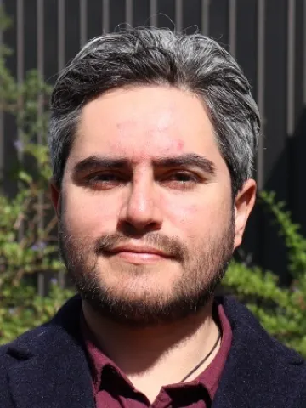
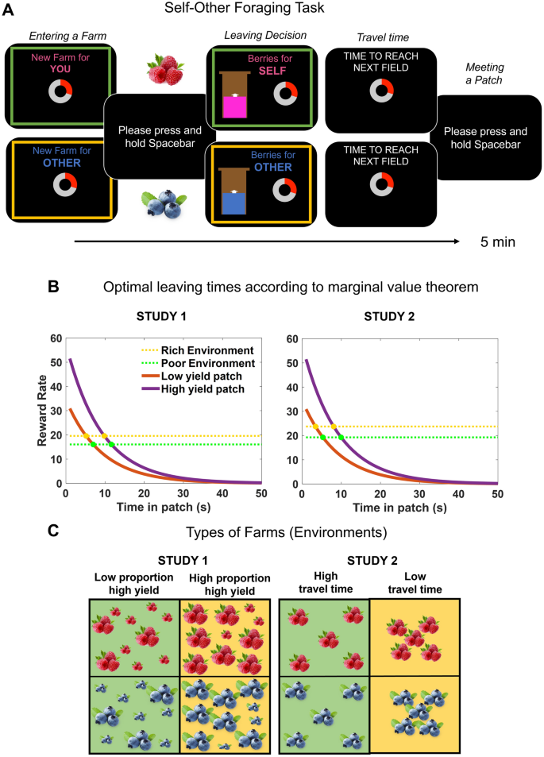
Self-Other Foraging Task
Do people forage less optimally when helping others?
Contreras-Huerta et al. (2025)
Notes:
Social deception – hand waving

Slide 9
Two studies: different kinds of environments

Slide 10
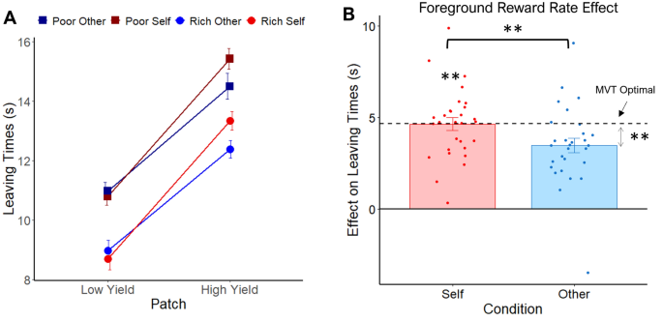
Study 2 results: travel time version

Slide 11
What is driving sub-optimal behaviour when helping others?

Slide 12
1. Identify an algorithm that could explain behaviour 2. Simulate data to check model robustness and behavioural effects 3. Design and run study optimised for modelling 4. Fit models to participants’ data 5. Compare models and select the “best” 6. Analyse parameters 7. Based on your results, come up with new models/experiments!
Your project: fit and compare models of prosocial foraging decisions

Slide 13
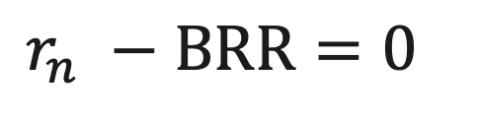
1. Identify an algorithm to explain behaviour: MVT
BRR, background reward rate
Assumptions: Each second (timestep, n) in the patch is a discrete stay or leave choice
r_{n}, patch reward rate
MVT rule: Leave a patch at timestep, n, when:
$$r_{n} −BRR=0$$
But this is too simplistic!
People make noisy – or ‘stochastic’ - choices
People may not have a fixed estimate of BRR, but instead this estimate may fluctuate over time
Image: BioRender

Slide 14
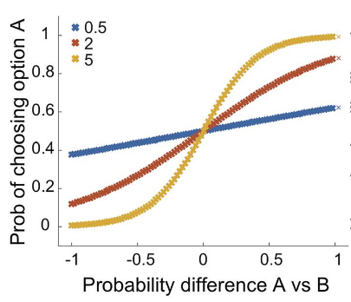
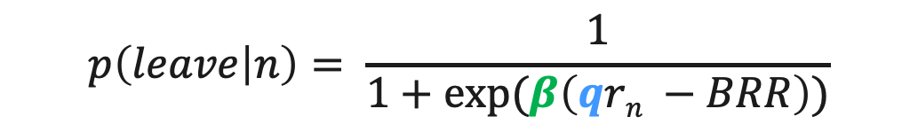
Modelling stochastic choices: softmax
Beta = softmax inverse temperature
Softmax function:
What is the probability of leaving the patch on every timestep?
$$p\left(leave | n\right)= \frac{1}{1+exp⁡(β\left(qrn −BRR\right))}$$
Probability of staying
q = patch reward sensitivity parameter – weight patch reward more strongly
Value difference (stay vs leave)

Slide 15
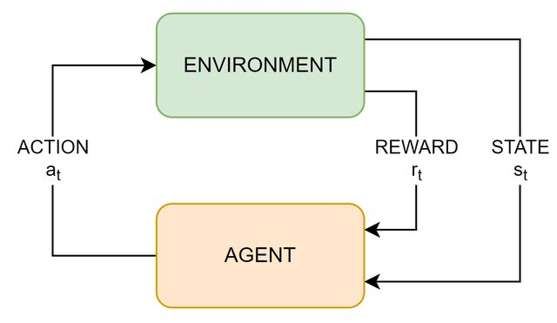
Modelling estimation of BRR: reinforcement learning (Rescorla-Wagner)
BRR_{n+1} = BRR_{n} + α(r_{n} - BRR_{n})
α = learning rate [0, 1]: how much agent weights most recent update
Prediction error
Image from Tedeschi et al (2022)

Slide 16
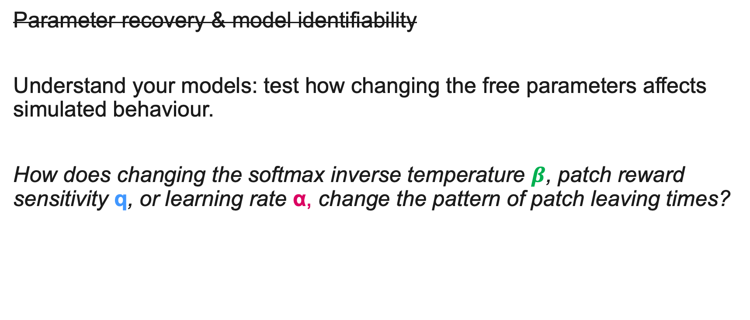
2. Simulate data to check model robustness and behavioural effects
Parameter recovery & model identifiability
Understand your models: test how changing the free parameters affects simulated behaviour.
How does changing the softmax inverse temperature $β$, patch reward sensitivity q, or learning rate α, change the pattern of patch leaving times?

Slide 17
3. Fit models to participants’ data
Aim: find set of parameters, θ, that can best explain a participant’s choices
Maximum Likelihood Estimation: minimizing the negative log likelihood (LL) of the data given the model parameters, θ.
Remember:
Maximizing the LL is the same as minimizing the negative LL
Timestep in patch (s) | Action | P(stay) | θ | P(leave) | θ | Log lik, LL
1 | Stay | 0.9 | 0.1 | -0.05
2 | Stay | 0.7 | 0.3 | -0.10
3 | Stay | 0.6 | 0.4 | -0.22
4 | Stay | 0.4 | 0.6 | -0.22
5 | Stay | 0.3 | 0.7 | -0.40
6 | Stay | 0.2 | 0.8 | -0.70
7 | Leave | 0.1 | 0.9 | -0.05
 |  |  | Total: | -1.74

Slide 18
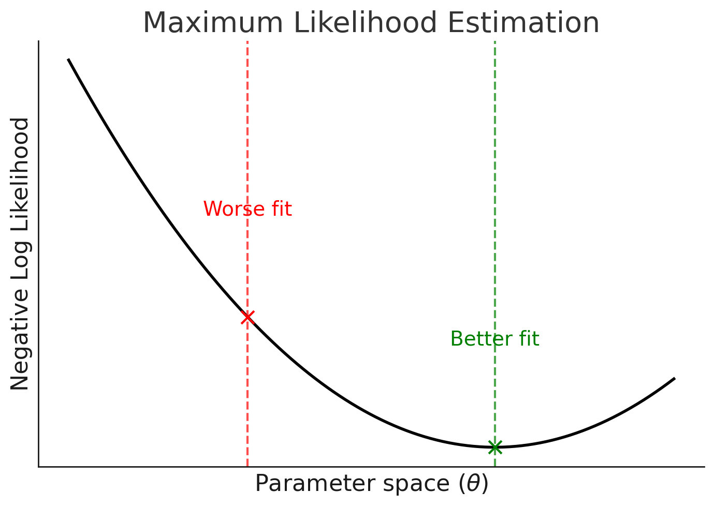
3. Fit models to participants’ data
How do we find the minimum?
fmincon in MATLAB
con: constrained (set parameter bounds)
best fit parameters for this participant
Image created with ChatGPT 5.0

Slide 19
4. Compare models and select the ‘best’
Aim: given the best parameters for each model, which model best explains behaviour?
AIC = 2k + 2 * NLL
BIC = 2 * NLL + k * log(n)
k: number of free parameters
n: number of choices observed
NLL: negative log likelihood
Both metrics favour simpler models (penalize complexity), but BIC is more strict

Slide 20
Your turn!
To download data and scripts go to:
https://github.com/escholey/CSC_foraging_group_2025
In the repository you should find:
Main MATLAB script: CSC2025_Prosocial_Foraging_script.m
Simulation/fitting functions in the model_functions folder
Data: data folder > exp2 > trialbytrial_exp2.csv (ignore other data)
Slides: CSC2025_prosocial_foraging_slides.pptx
Solutions if you’re stuck in the solutions folder, and for the main script: CSC2025_Prosocial_Foraging_SOLUTIONS_script.m

Slide 21
Over to you
Work your way through the script as a group or in pairs.
% ** means something to do
Ask if you’re not sure!

Slide 22
BONUS!
Well done for getting here!
You have learnt the basics, but I’m sure you have more ideas. Some suggestions are below,
but feel free (and you are encouraged!) to come up with your own ideas.
Data questions
How do the model parameters correlate with questionnaire data e.g. apathy or empathy scores?
What other model comparison metrics could you use? e.g. R², exceedance probabilities
Fit the models to the data from the first experiment. Make sure you change the necessary task variables in the simulation script. Do you find the same best fitting model? Does this model capture the data any better?
Theory questions
The winning model still isn’t a good fit to the data. Think about alternative models. For example:
the simulated environment effect is smaller than real data. Why? How could you change the model?
how could you account for the shrunk environment effect in the low yield patch? How would you specify these models? Feel free to use your AI friends. If you have time, try fitting them!
Can you think of completely different models than RL, such as drift diffusion models or Bayesian models? What do you expect the parameters of these models will show for self versus other?

